Slide 1
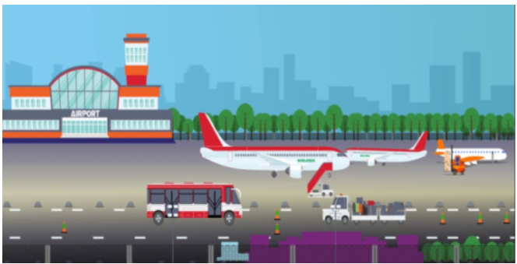
Workshop In Software Models SmartAirport Project
Beniyamin Rubinstien, Noi Cohen and Ido Lavi
Prof.Shahar Maoz Workshop
School of Computer Science
Tel Aviv University, Israel

Slide 2
Spectra Requirements
Functioning Airport based on variables, guarantees and assumptions which are declared, defined and synthesized using the Spectra language
No collisions between airplanes
No collisions between airplanes and other vehicles (rescue and cleaning vehicles)
Four airplanes at most can use the airport runways – two waiting for landing and two for takeoff
Two airplanes can land or takeoff at the same time using Four runways – based on the controller decision
Supporting emergency landing priority
Dealing with combined situation of mechanical problem, slippery runway and emergency landing, while prioritizing traffic

Slide 3
GUI Requirements
Functioning GUI based on the Spectra controller
GUI follows the defined assumptions and guarantees in the Spectra Specification
GUI is based on the Spectra specification controller
Display screen showcasing the simulation according to the controller
Automatic and manual environment modes
Pre-defined scenarios mode that will showcase different situations within the Airport

Slide 4
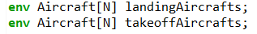
Environment Specification
Four different takeoff/landing platforms are available to use in the Airport
Airplanes can be one of the next four options:
Cargo
Private
Commercial
None
Enum arrays representing the planes that are waiting for takeoff and landing in the different platforms
Index i – an airplane waiting for takeoff/landing at platform i .

Slide 5
Environment Specification
Four different runways are available to use in the Airport
The runways are divided into 2 groups:
1st and 2nd lanes serve landing platform 1 and takeoff platform 1.
3rd and 4th lanes serve landing platform 2 and takeoff platform 2.
Each landing/takeoff platform contains a single airplane waiting for
either landing or taking off at the most

Slide 6
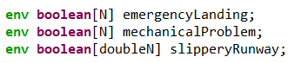
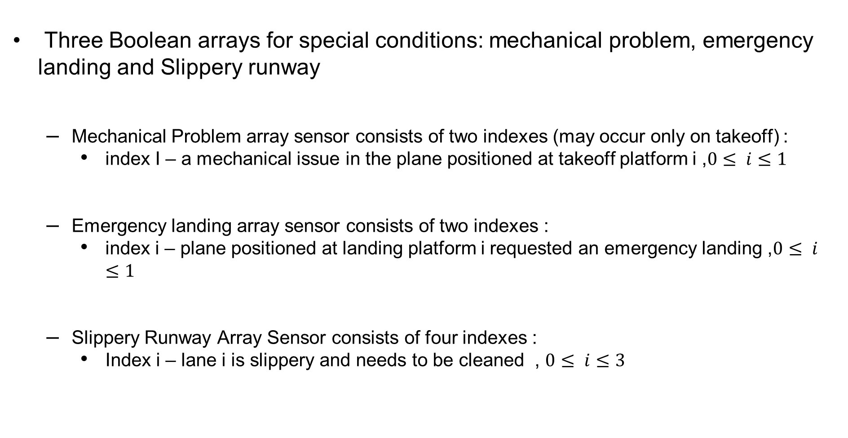
Environment Specification
Three Boolean arrays for special conditions: mechanical problem, emergency landing and Slippery runway
Mechanical Problem array sensor consists of two indexes (may occur only on takeoff) :
index I – a mechanical issue in the plane positioned at takeoff platform i ,$0≤ i≤1$
Emergency landing array sensor consists of two indexes :
index i – plane positioned at landing platform i requested an emergency landing ,$0≤ i≤1$
Slippery Runway Array Sensor consists of four indexes :
Index i – lane i is slippery and needs to be cleaned , $0≤ i≤3$

Slide 7
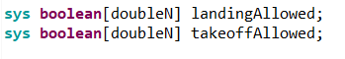
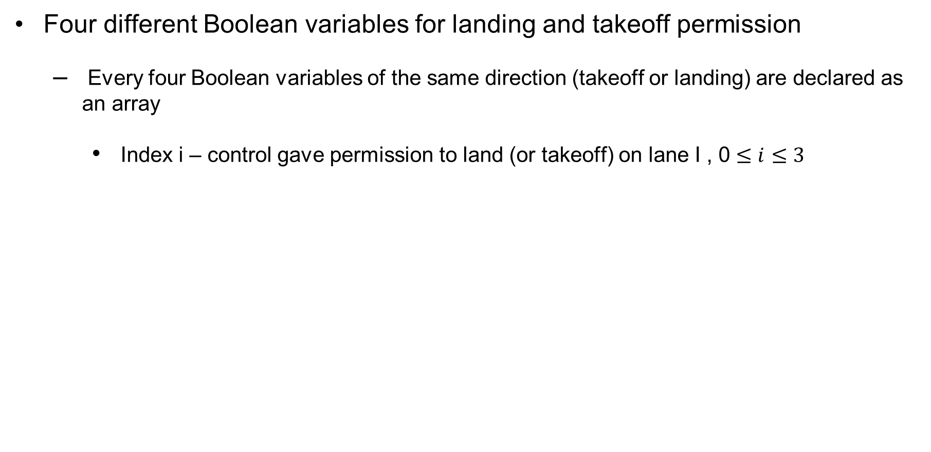
System Specification
Four different Boolean variables for landing and takeoff permission
Every four Boolean variables of the same direction (takeoff or landing) are declared as an array
Index i – control gave permission to land (or takeoff) on lane I , 0 $≤i≤3$

Slide 8
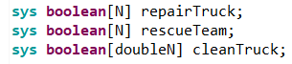
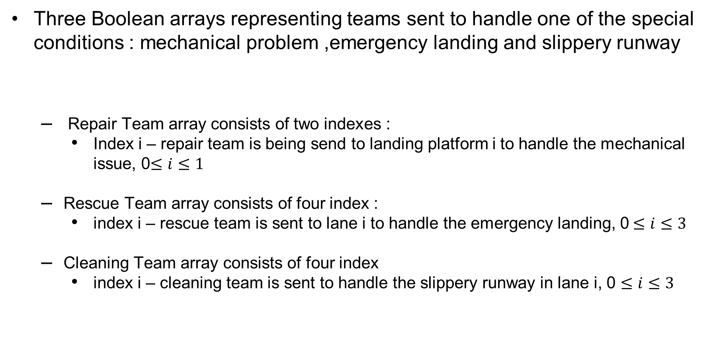
System Specification
Three Boolean arrays representing teams sent to handle one of the special conditions : mechanical problem ,emergency landing and slippery runway
Repair Team array consists of two indexes :
Index i – repair team is being send to landing platform i to handle the mechanical issue, 0$≤i≤1$
Rescue Team array consists of four index :
index i – rescue team is sent to lane i to handle the emergency landing, 0$≤i≤3$
Cleaning Team array consists of four index
index i – cleaning team is sent to handle the slippery runway in lane i, 0 $≤i≤3$

Slide 9
Specification Assumptions
Consistency – airplane wishing to land or takeoff won’t disappear until they’ll get the permission to land or takeoff
Consistent condition – if a plane encounters one of the special conditions mentioned, the issue won’t go away until its fixed
Emergency exclusion – at any point in time the airport will allow only one plane to be in state of an emergency
Not Always emergency - there won’t be emergency landings indefinitely
Special condition handled – if a caretaker team arrived to handle the special condition in the next state the issue will be resolved

Slide 10
Specification Guarantees
Eventually taking off or landing – every plane that is waiting for take off or landing will get the permission to do so
No collisions – the same runway can’t be used for both landing and takeoff at the same time
Caretaker team is sent only if the special condition occurred
Eventually caretaker team arrives – in mechanical and slippery runway issues the problem will eventually be fixed
Slippery lane can’t be used – takeoffs and landings are not allowed on a slippery lane at any point in time

Slide 11
Specification Guarantees
Plane with mechanical issue can’t takeoff – at any point in time a plane with mechanical problem isn’t allowed to preform takeoff
No traffic while emergency landing – at any point in time if emergency landing is performed no other takeoffs or landings are allowed
Rescue team responds immediately – when emergency team is preformed rescue team will come in the next state

Slide 12
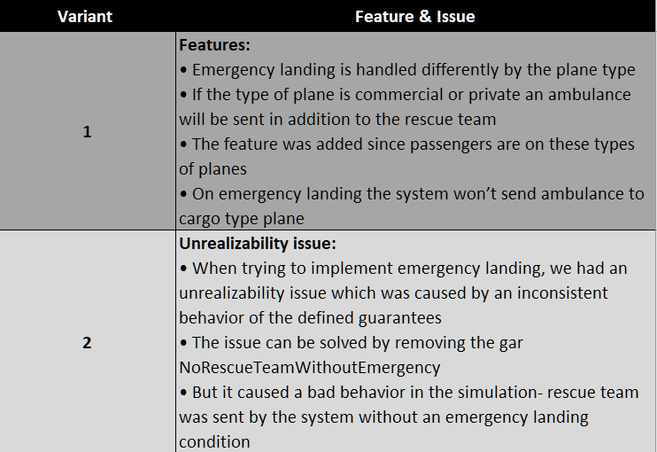
Spectra Variants

Slide 13
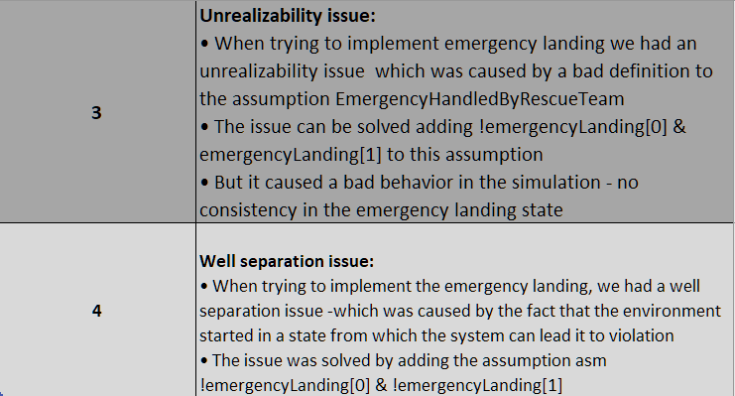
Spectra Variants

Slide 14
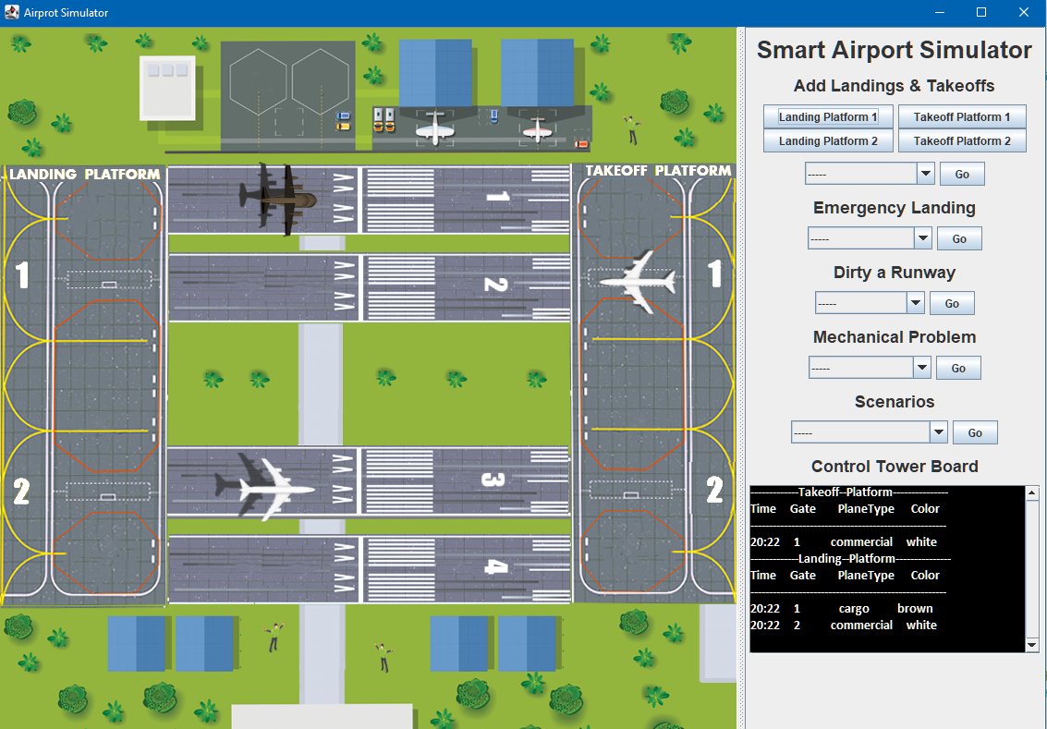
Simulator
Manual menu
Scenario menu
Control tower & Information panel
In order to draw the animation, the simulation draws each state one at a time.
Minimal requirement is a resolution above 1150*850.

Slide 15
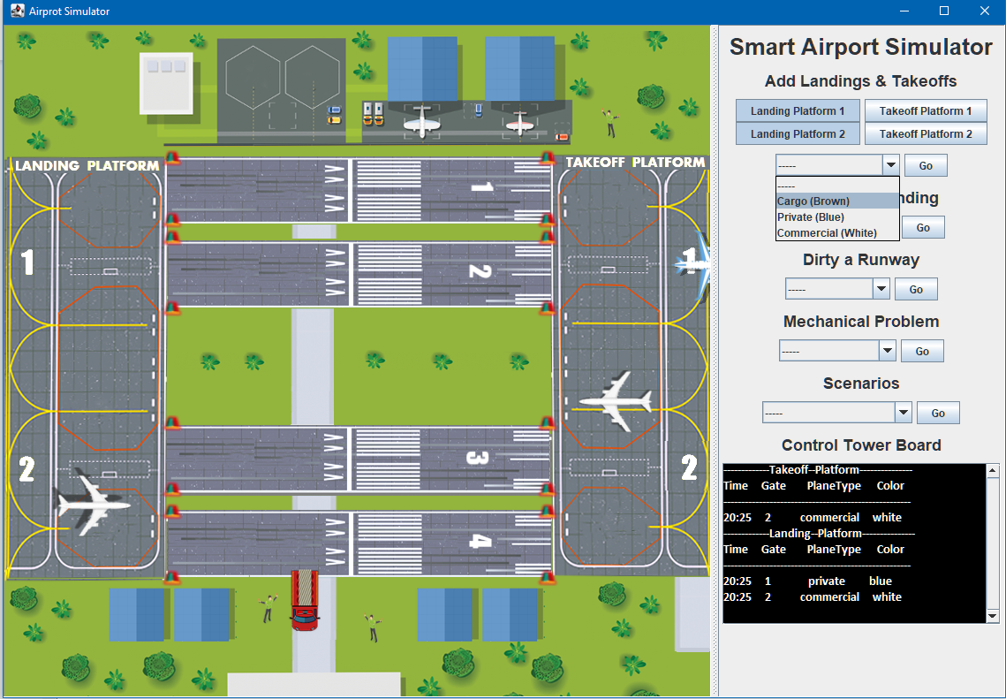
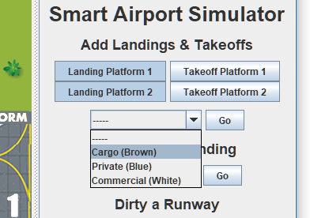



Manual mode – Injecting airplanes
1. select takeoff/landing planes
to arrive to the desired platform
using toggle buttons.
2. Select type of airplane to appear
using dropdown.
3. Press Go button.
4. Wait until the desired platform will
be clear to see airplane appear.
Type of airplanes:
Cargo: Commercial: Private:

Slide 16
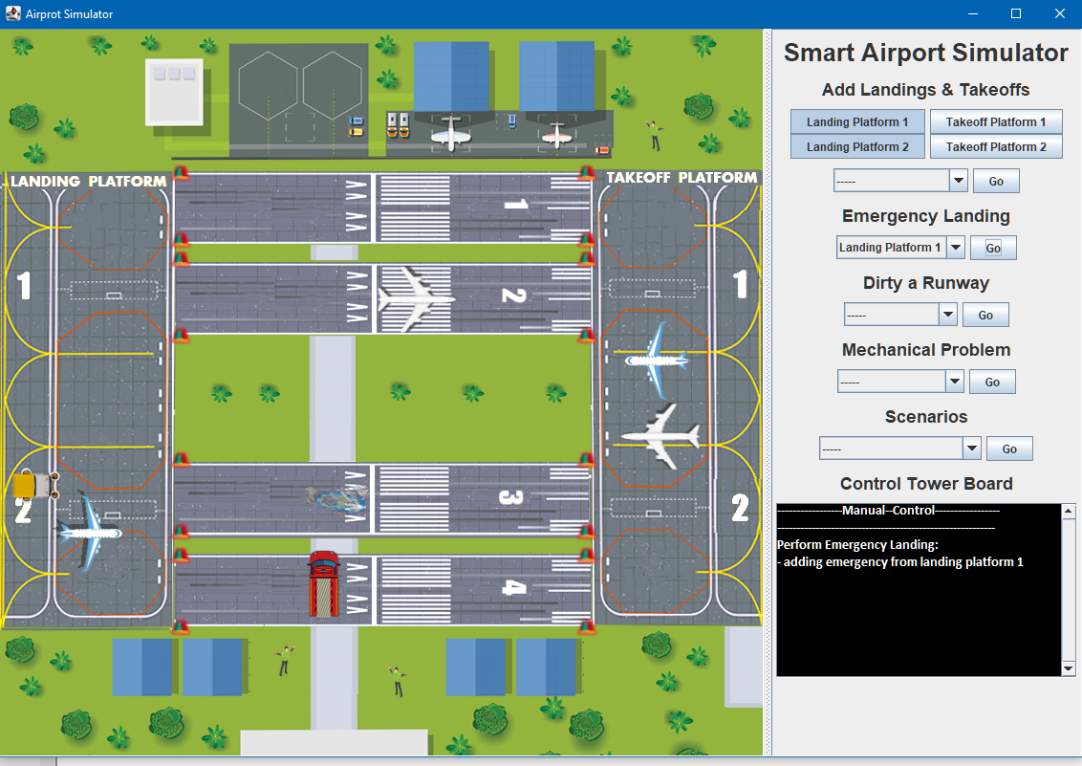
Manual mode – Emergency landing
1. Select a landing platform
from which an airplane will
perform emergency landing.
2. Press Go button.
3. Policy- no other airplane transport
is allowed and rescue team will
arrive to the runway the airplane landed on.

Slide 17
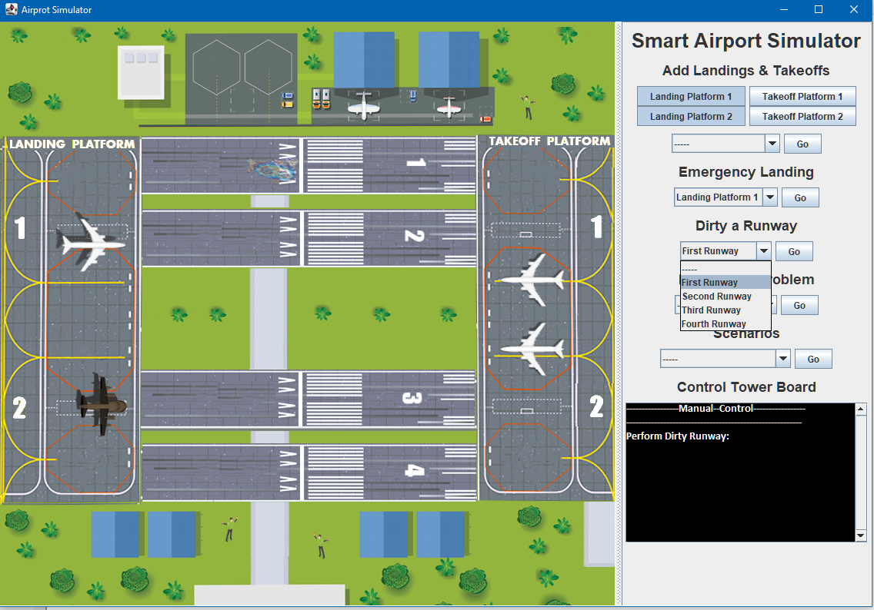
Manual mode – dirty a runway
1. select a runway to dirt
using dropdown.
2. Press Go button.
3. Policy – runway will
be blocked
until cleanup.

Slide 18
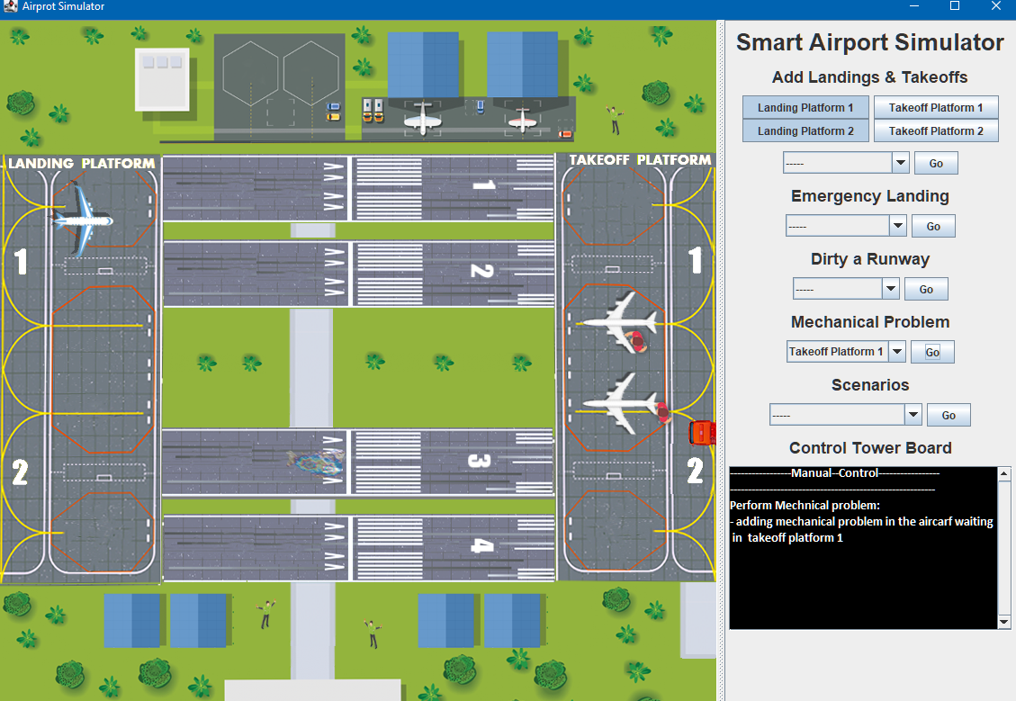
Manual mode – Mechanical Problem
1. Select takeoff platform
that will have a mechanical
problem.
2. Press Go button.
3. Policy – Problematic plane
will not take off until fixed
by mechanic.

Slide 19
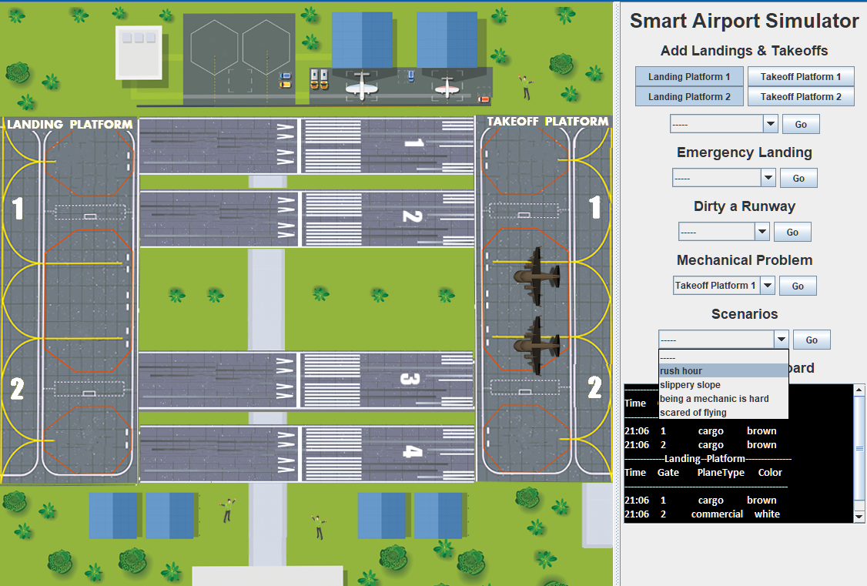
Scenario Modes
1. Choose scenario from 4
pre-defined scenarios.
2. Press Go button.
3. Let the scenario begin…
4. When scenario over,
information panel will
print “DONE”.

Slide 20
Pre-defined Scenarios
Scenario | Description | Purpose
1. Rush hour | Planes coming for landing and takeoff from all 4 platforms. no emergency landings, mechanical problems or slippery runways. | To show there are no collisions between airplanes.
2. Slippery Slope | Runways gets dirty and slippery with high probability. no emergency landings or mechanical problems. | To show how the airport handle slippery runways, by sending cleaning cars and blocking runways for takeoff/landing.
3. Being a mechanic is hard | Airplanes waiting for takeoff having mechanical problems with high probability. no emergency landings or slippery runways. | To show how the airport handle a mechanical problem, by sending a mechanic team and not granting takeoff permission.
4. Scared of flying | Emergency landing occurs with high probability. No mechanical problems or slippery runways. | To show how the airport handle an emergency landing, by blocking all other traffic and sending a rescue team.

